Slide 1


ECEN 403 Midterm Presentation
GPT NLP Lab Assistant Team #: 35 Muhammed Faseeh
Michael Fritzer
David Haybarger
Kevin Lee
TA: Fahrettin Ay

Slide 2
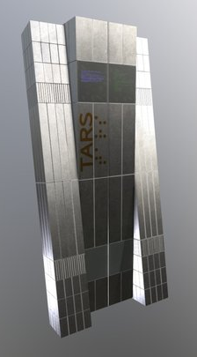
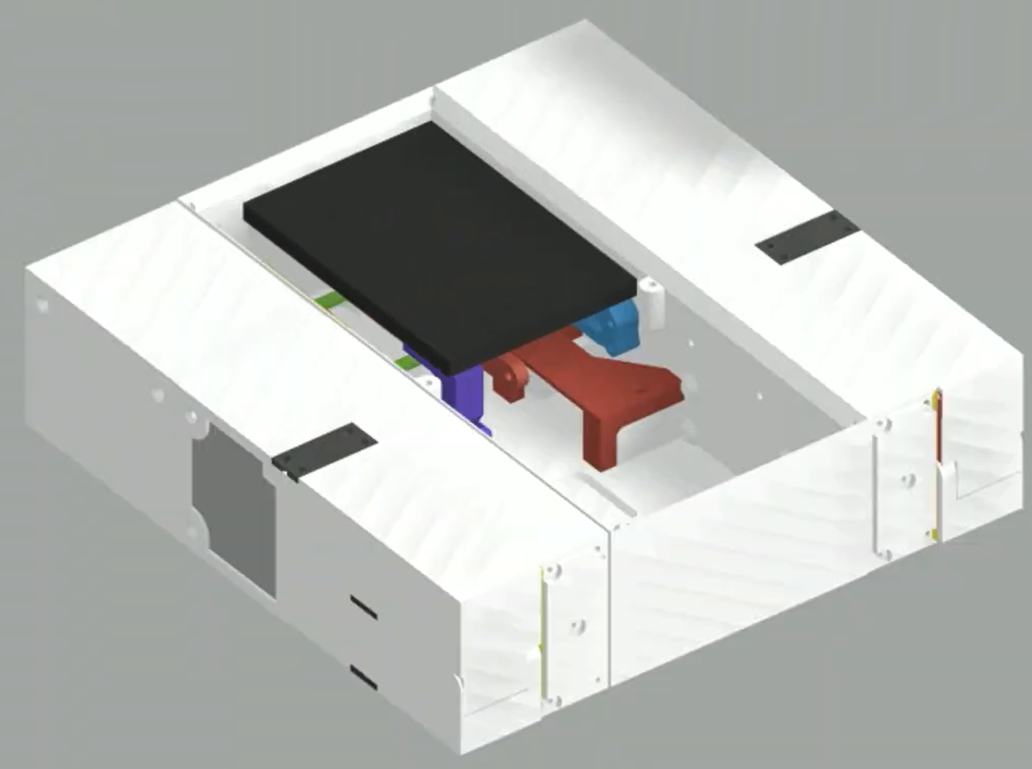
Project Summary
Problem statement:
Students & researchers often face challenges completing tasks due to a lack of quality assistance caused by Assistants & Professors unavailability.
Our Solution:
Build a lab assistant that is capable of subsidizing most functionalities that a TA or professor would generally provide combined with the advantages of having an LLM on standby.
Notes:
David will Read

Slide 3
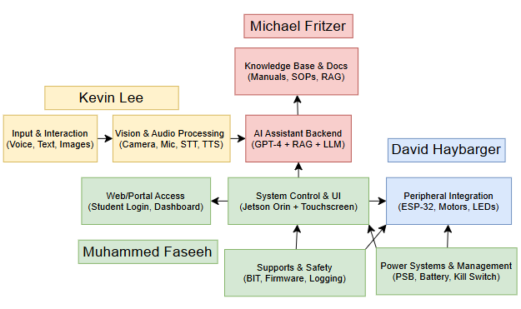
System Overview
Notes:
Cloud server and database, Muhammed will do a quick glanceover

Slide 4
Voice and Image Interface – Kevin Lee
Goal:
Enable speech-driven interaction with real-time STT → AI → TTS response
Combine speech and image understanding (multimodal AI) for contextual question answering
Design Tools:
STT: OpenAI Whisper
TTS: Coqui TTS / PyTorch Vocoder
Vision: Segment Anything Model (SAM 2) + OpenCV
Design Plan:
Speech Input: Analog audio → USB ADC → Whisper STT
Censorship & Translation: Lexical filter → Language detection → Translation to English
AI Processing: Text → Local LLM + RAG → Contextual Answer Generation
Output: TTS → DAC → Speaker / Display UI Response
Optional Vision: Camera image → SAM/OpenCV → Fused with STT for multimodal query

Slide 5
Voice and Image Interface – Kevin Lee
Microphone
Metric | Performance | Justification
STT Accuracy ≥ 95% | Ensures high transcription fidelity for user speech | Whisper Base model achieves ≥95% accuracy under standard acoustic conditions
Translation Accuracy ≥ 90% | Maintains semantic integrity across multilingual inputs | Supported by integrated language detection and neural translation models
TTS Speech Clarity ≥ 4.0 MOS | Guarantees natural and intelligible voice output | MOS ≥4.0 corresponds to near-human perceptual quality in speech synthesis
Response Latency ≤ 1.0 s | Provides real-time conversational interaction | Matches end-to-end target for human-like responsiveness in lab settings
ADC
Camera/
Image
Whisper STT
SAM2+
OpenCV
Censorship/
Translation
LLM+RAG
TTS
Speaker/ Display

Slide 6
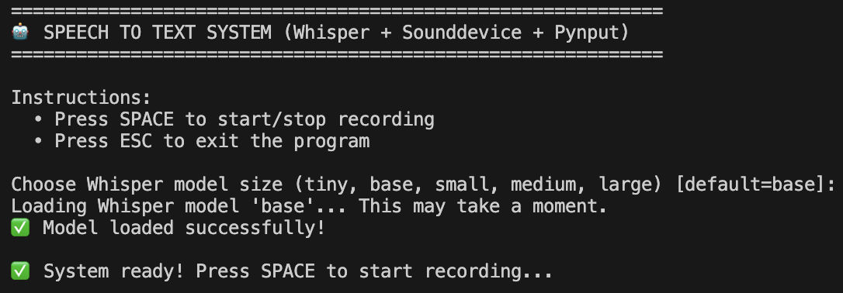
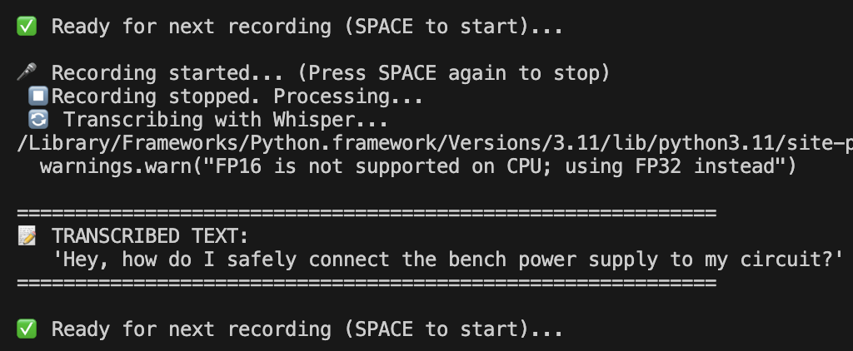
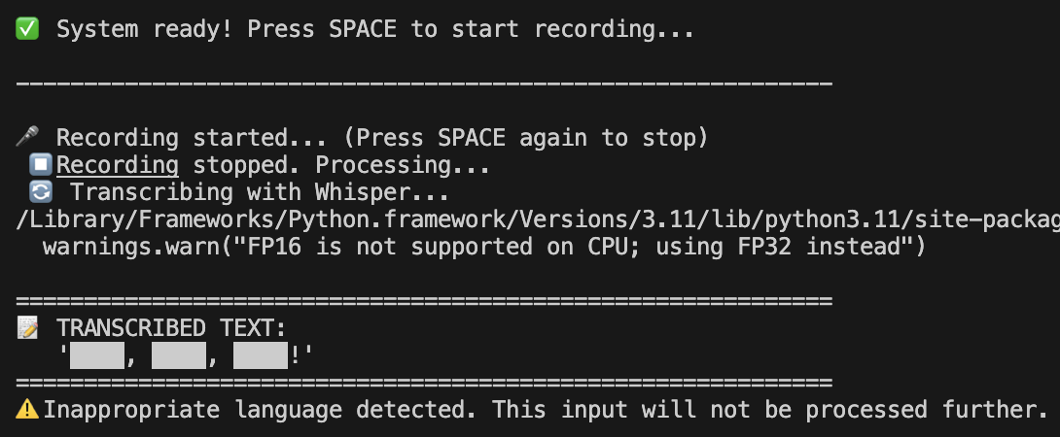
Voice and Image Interface – Kevin Lee
Figure 1. Whisper model size comparison showing differences in capacity and accuracy—Tiny/Base models are suitable for standard STT, while the Medium model is recommended for automatic translation tasks.
Figure 2. Speech-to-Text (STT) workflow illustrating real-time audio capture, transcription, and text output using the Whisper model.
Figure 3. Inappropriate language detection flow demonstrating how censored input is filtered and excluded from AI and TTS processing.

Slide 7
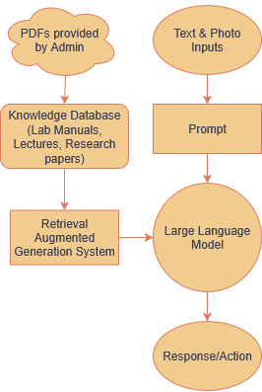
Artificial Intelligence – Michael Fritzer
Goal:
Build the Large Language & Computer Vision Models the robot will operate under.
Design Tools:
Git & VScode for code creation.
Python main language utilized.
LightRag & Ollama to run local LLM with Retrieval Augmented Generation (RAG).
PyTorch, cv2, & segment_anything used for Computer Vision Model
Design Plan:
LLM being designed based on Metas Ollama project & LightRAG Arxiv paper.
Computer Vision model based on Metas Segment Anything Model (SAM).

Slide 8
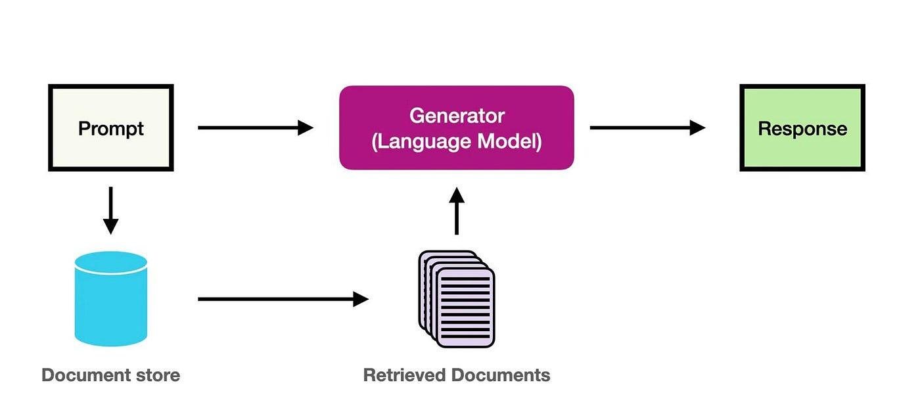
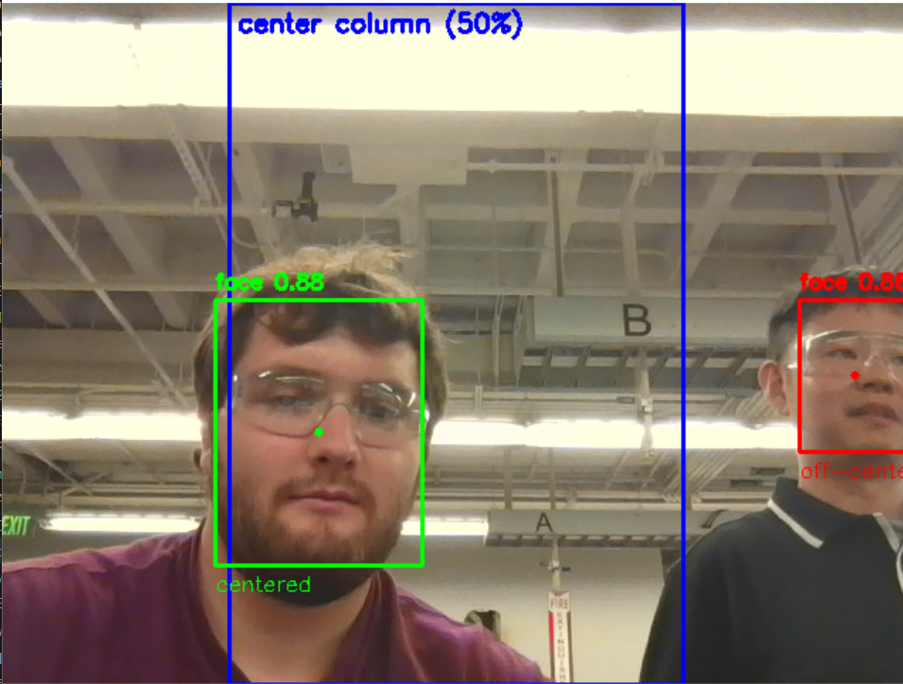
Artificial Intelligence – Michael Fritzer
Objective:
Take in text and cleaned images & output reference documents, LLM generated answers, and actions.
Inputs:
Text from voice & imaging interface.
Images.
Outputs:
Text for display & Text-to-Speech.
Relevant documents for Sourcing.
Commands for movement.

Slide 9
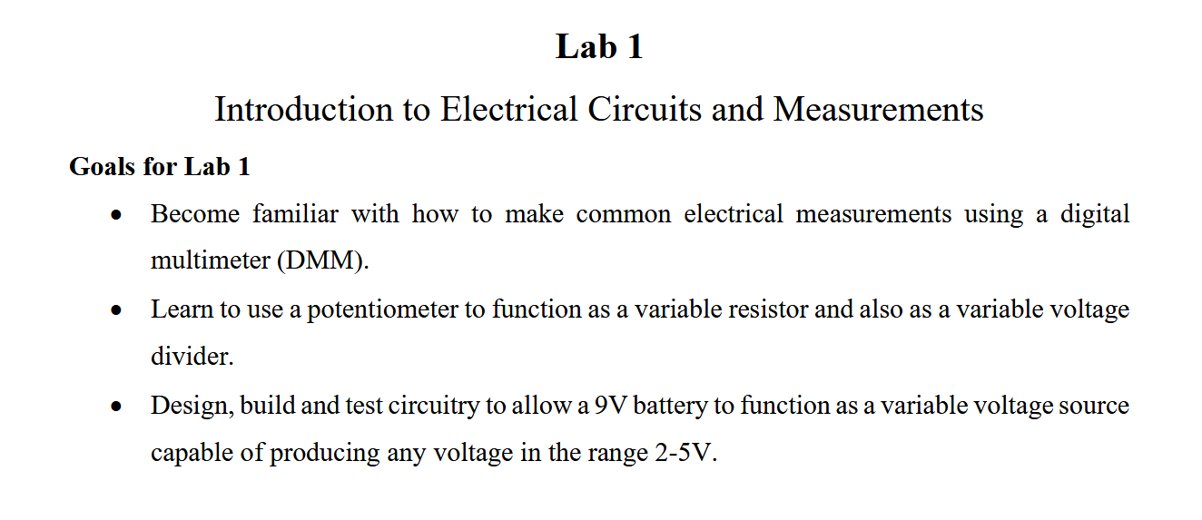
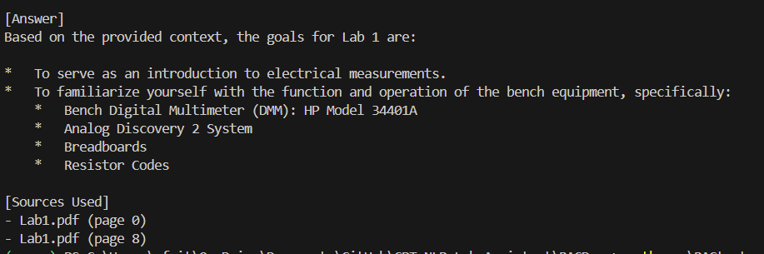
Artificial Intelligence – Michael Fritzer
Example of current LLM-RAG execution.
“Please state the goals of Lab 1 in ECEN 214”
Lab 1 Page 1 (identified as page 0 in NaiveRAG)
Response from LLM utilizing NaiveRAG

Slide 10
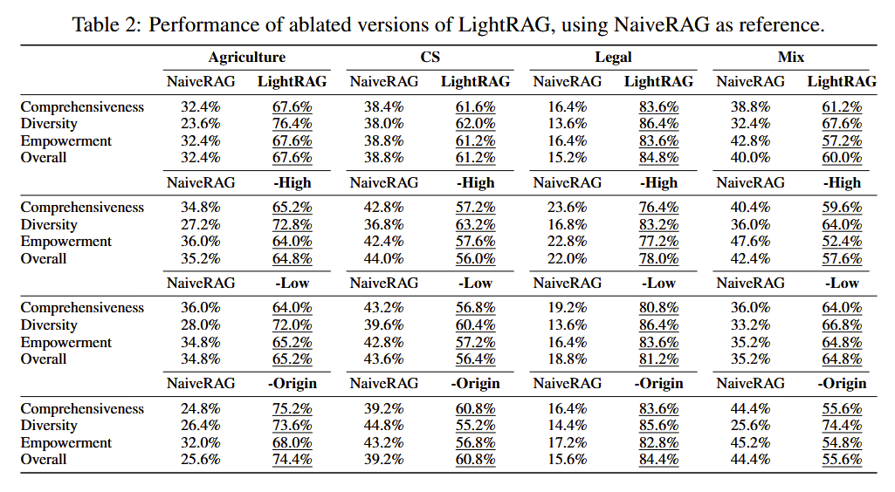
Artificial Intelligence – Michael Fritzer
Guo, Z., Xia, L., Yu, Y., Ao, T., & Huang, C. (2025). LightRAG: Simple and Fast Retrieval-Augmented Generation. arXiv. https://doi.org/10.48550/arXiv.2410.05779

Slide 11
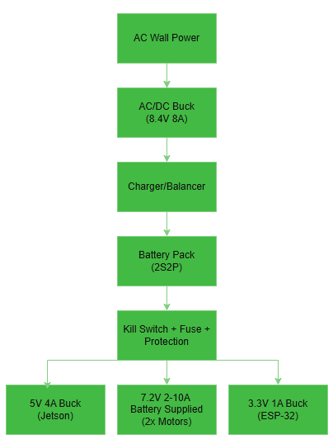
Hardware – Muhammed Faseeh
What the subsystem does
Uses 2S2P INR18650-P26A Li-ion battery pack with buck converters to adjust voltage and amperage.
Handles power regulation, surge protection, and kill switch safety.
Supplies stable 5V @ 4A to Jetson Orin, 3.3V @ 1A to ESP-32, and 7.2 V @ 1A per Servo.
Provides battery %, runtime, and logs to the UI (tablet + web).
Design and implement in Altium as a custom PCB integrating charger, protection, and buck converter stages.

Slide 12
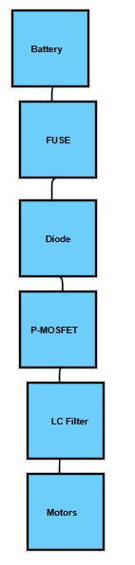
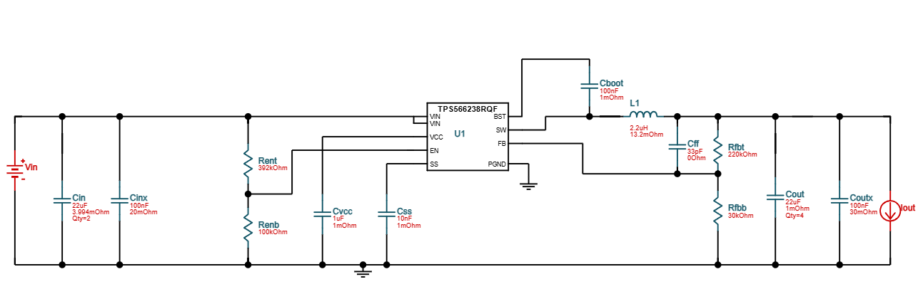
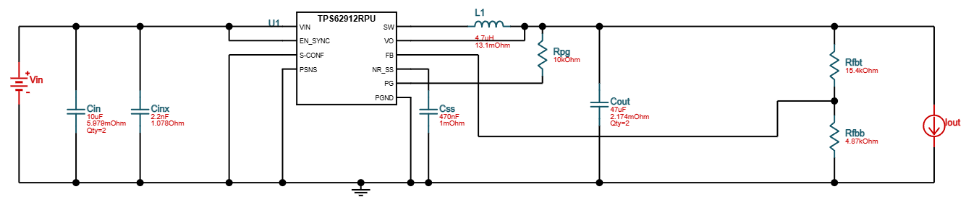
Hardware – Muhammed Faseeh
TI - WEBENCH (DC/DC)
Motors:
Jetson:
ESP-32:

Slide 13
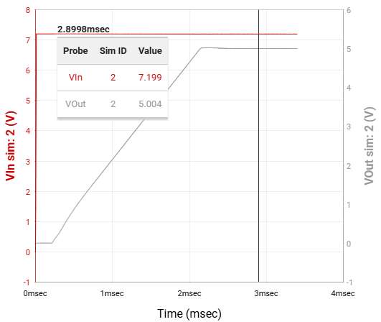
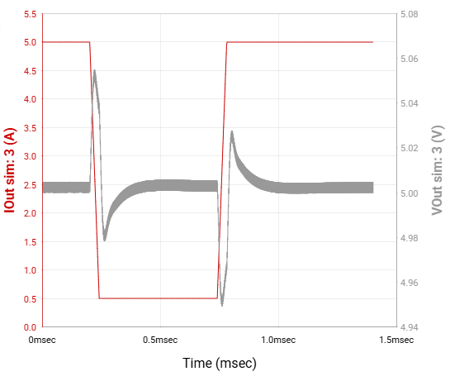
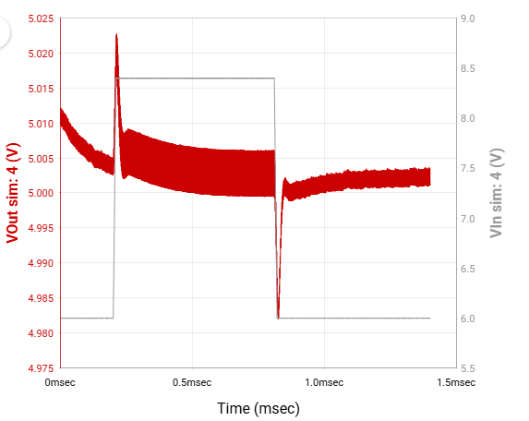
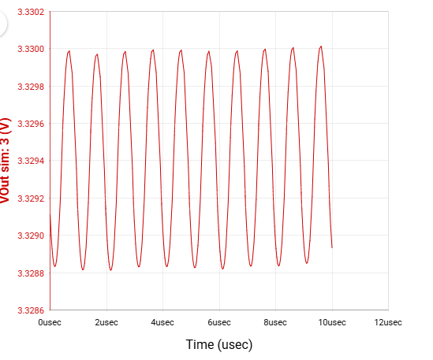
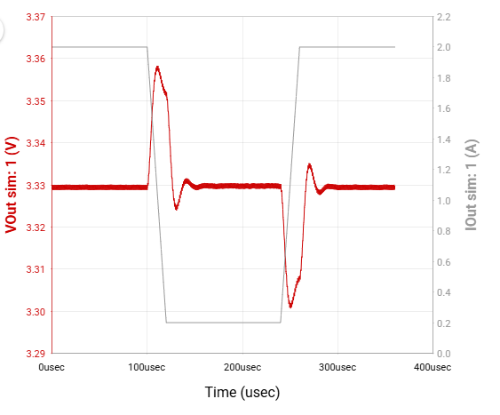
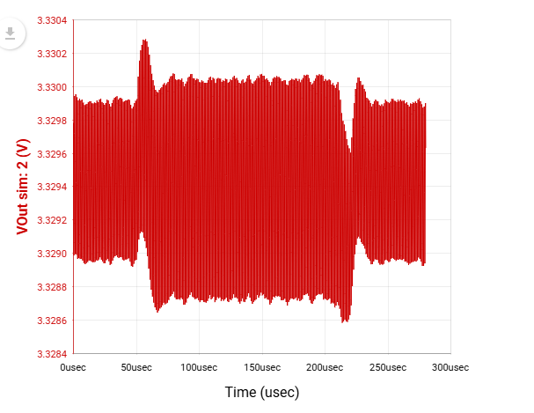
Hardware – Muhammed Faseeh
TI - WEBENCH (DC/DC)
Jetson:
ESP-32:

Slide 14
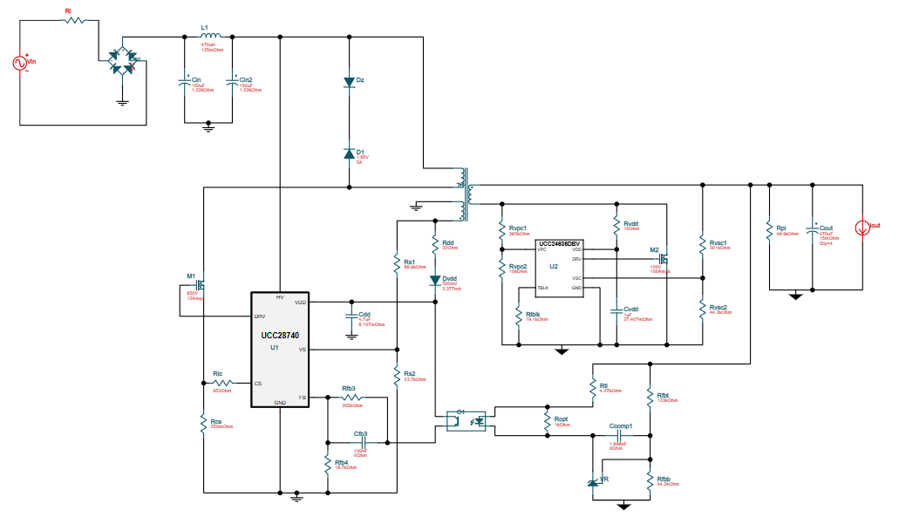
Hardware – Muhammed Faseeh
TI WEBENCH Power System
(AC/DC Front End)
Simulated an isolated 120 VAC → 10 VDC @ 8 A power stage using TI WEBENCH.
Used for modeling and validation only, the actual prototype will be powered via UL-certified external adapter.
Supplies safe DC input to custom battery charger and buck converter network.

Slide 15
Hardware – Muhammed Faseeh
Component | Options | Pros | Cons | Final Choice
Battery Chemistry | Li-ion vs LiFePO₄ | Higher energy density & discharge current | Slightly less cycle life | INR18650-P26A (2S2P ≈ 7.2 V 5.2 Ah)
Regulator | Linear vs Buck | High efficiency, compact | EMI filtering needed | Buck Converter
UI Platform | Local vs Web | Web = multi-device access | Needs Wi-Fi setup | Hybrid Tablet + Web
Lang/Stack | C++ vs Python | Fast dev, Jetson support | Slightly slower | Python + Flask (Frontend JS UI)

Slide 16
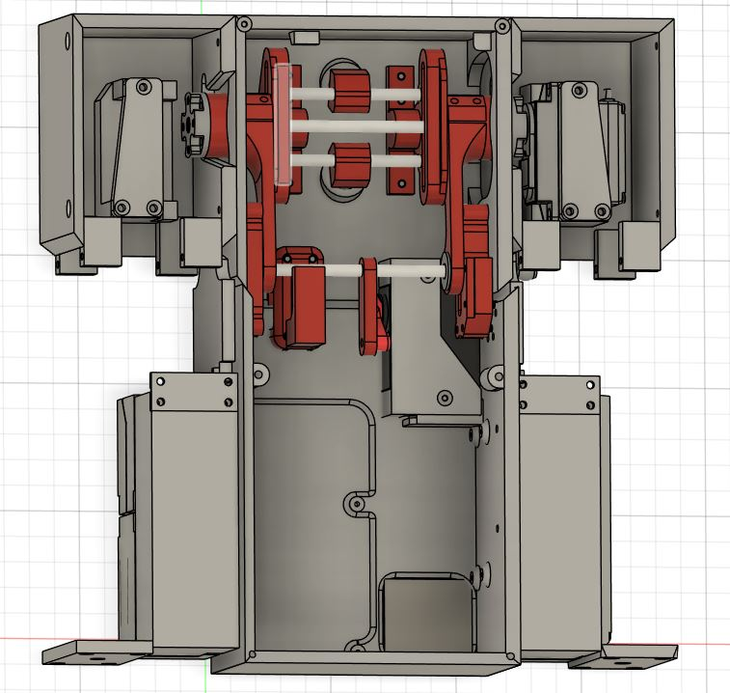
Robotics – David Haybarger
What does the subsystem do?
Provide physical actuation, movement, and probe deployment.
Objectives & Constraints
Stable and autonomous motion
AI interfaced control
Lab bench compatible
First Shell and Mechanical System Prototype
SERVOS
CAD Designs Based on C. Diaz TARS CAD Files

Slide 17
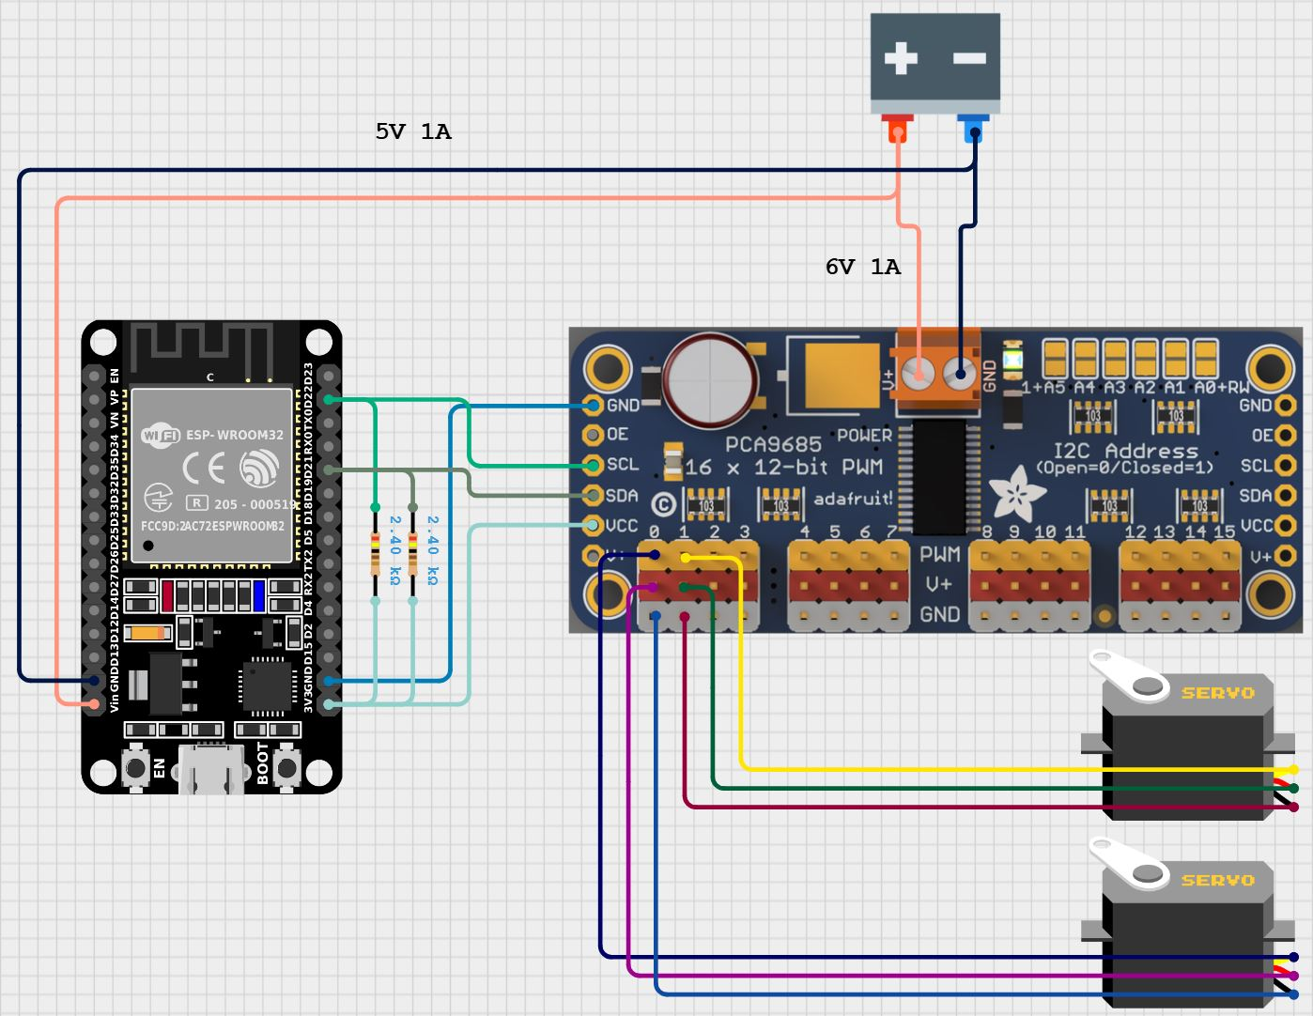
Robotics – David Haybarger
Design Tools
Autodesk Fusion 360
Arduino IDE
3D Printed Fabrication
Components
ESP32
LD-3015MG
PCA9685

Slide 18
Robotics – David Haybarger
Component | Options | Pros | Cons | Final Choice
Actuators | LD-3015MG Bilda 2000-0025-002 MG996R | Highest torque to cost ratio | Weight and Power Draw | LD-3015MG
Microcontroller | ESP32 Arduino Nano RP Pico | Fast, Wireless Connectivity, Lots of timers/PWM | 3.3V logic only | ESP32

Slide 19
Project Execution & Validation
 | 10/8 - today | 10/22 | 11/5 | 11/19 | 11/26
Voice & Image Interface (Kevin Lee) | Voice-Controlled Response Demonstration | Multimodal (Image + Speech) Query Processing Enabled | Audio System Integrated and Tested with Power System | Image-to-text/ Text-to-speech functionality Integrated | Multimodal Voice–Vision– Control Operation Functional
Artificial Intelligence (Michael Fritzer) | Have base LLM (from API), RAG, & CV model operational | Integrate Local LLM based off LightRAG. | Build Database & Website for remote upload of documents. | Integrate document-side image recognition into LLM. | Integrate action outputs. Validate full system functionality.
Hardware (Muhammed Faseeh) | Began 2S2P battery pack and PCB implementation | Finalize PCB + begin basic UI power display layout | Assemble PCB, test voltage output, link Jetson to UI battery data | Verify ripple, thermal stability, and UI updates under load | Validate full power + UI integration with Jetson system
Robotics (David Haybarger) | Control System Prototype Constructed/ Tested | Control System Integrated with Mechanical Design/Shell | Control System PCB Designed and Tested | BluePad32 Library Integration/ Testing | Functional Robotic System with Bluetooth Control

Slide 20

Autonomous University Robot Assistant
Thank You!

